Slide 1

WELCOME

Slide 2
THANK YOU TO OUR SPONSORS

Slide 3






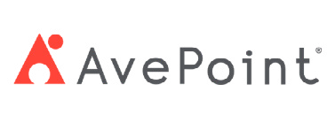

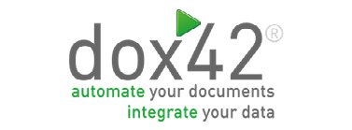








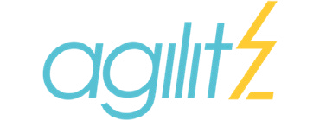





THANK YOU TO OUR SPONSORS
3

Slide 4
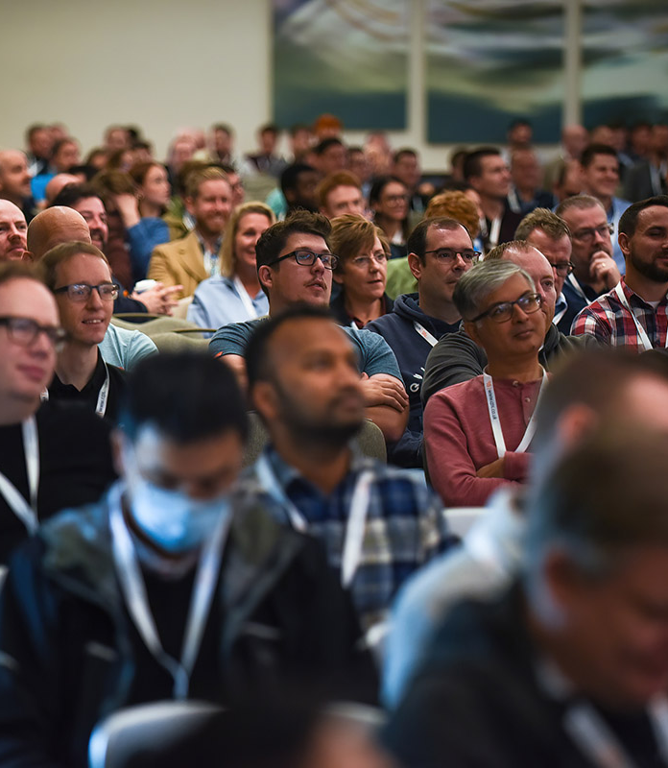
Copilot Studio Extensibility
Mats Necker &
Daniel Laskewitz
Notes:
MANDATORY SLIDE

Slide 5

Mats Necker

Slide 6

Daniel Laskewitz

Slide 7
Introduction
Who has worked with Power Virtual Agents?
How many people have experience with Copilot Studio?
Who is a developer?
Who is a maker?
Who built a Custom Connector?
Who has an agent in production?

Slide 8
Agenda
Introduction
Setup
Agent
Custom Connector
MCP

Slide 9
Now onto the marketing stuff…

Slide 10
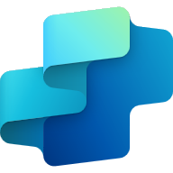

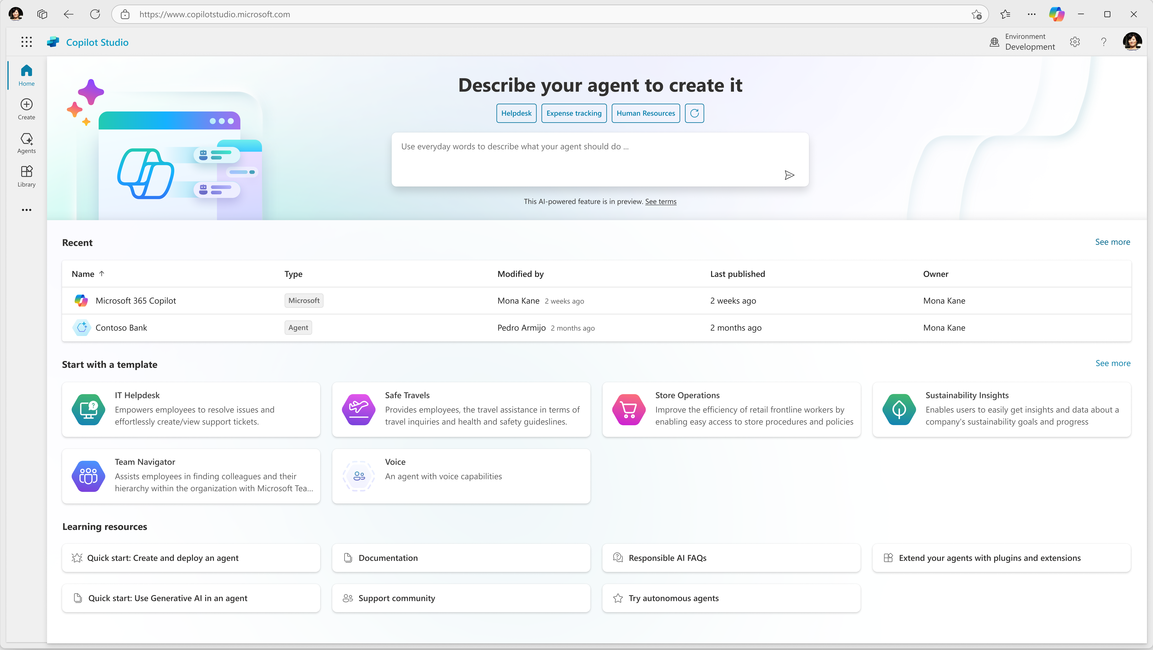
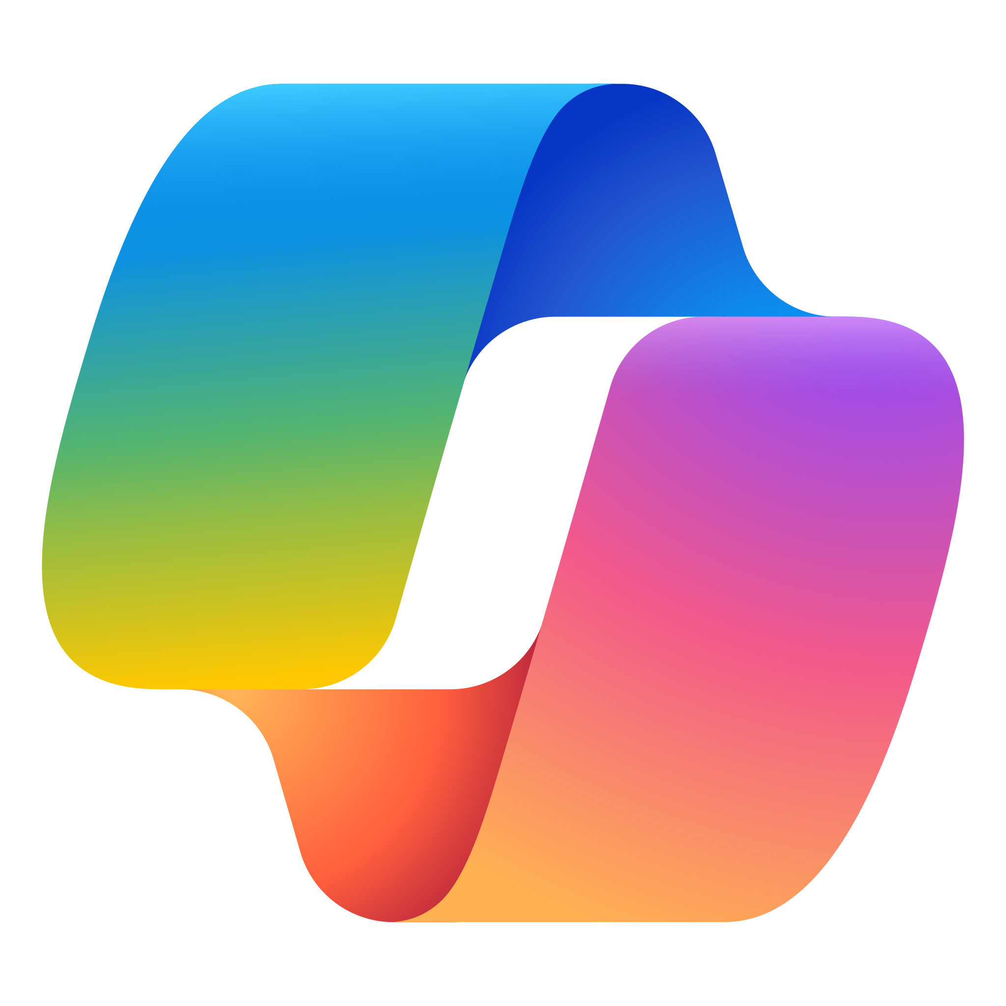

Copilot Studio
Copilot Studio is your tool for building agents and extending Microsoft 365 Copilot.
Meet your users where they already are
Access everything in one place
Automate your workflows
Integrate with your external apps
Connect to your data in Microsoft 365
+
+
Building enterprise agents to transform business processes
Enhancing MS Copilot to improve information workers productivity
Works with Azure Foundry
Notes:
Copilot Studio is the platform that makes these AI agents a reality for organizations like Zava. It’s the single place where Alex can:
Meet users where they already work — inside Microsoft 365 apps.
Access all the necessary data in one view.
Automate workflows across systems.
Integrate with external apps and data sources. And it’s built to extend Microsoft 365 Copilot — so instead of just answering questions, it can actually take action and deliver outcomes.
Copilot Studio is your central tool for building agents and extending Microsoft 365 Copilot.It lets you meet users where they already work—integrating with Microsoft 365, automating workflows, and connecting to external apps and data.
You can access everything in one place, making it easy to build, test, and deploy agents.
Copilot Studio is designed for both business process transformation and productivity enhancement for information workers.
It also works seamlessly with Azure Foundry, enabling advanced scenarios and integrations.

Slide 11
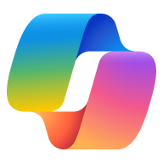

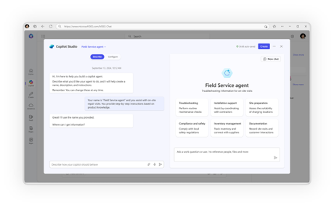
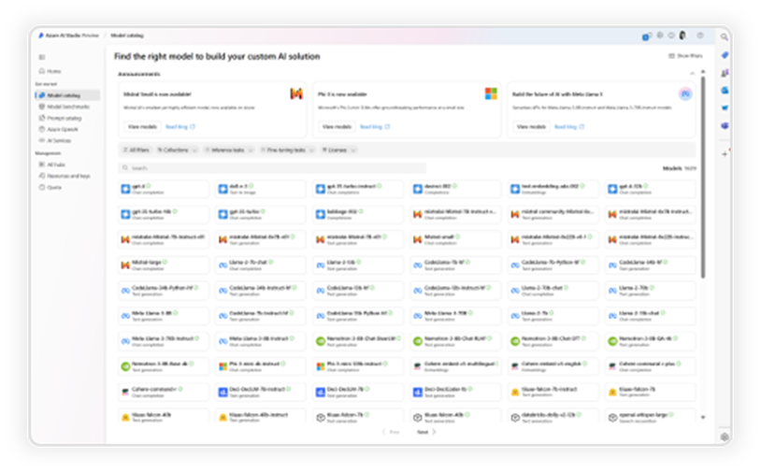
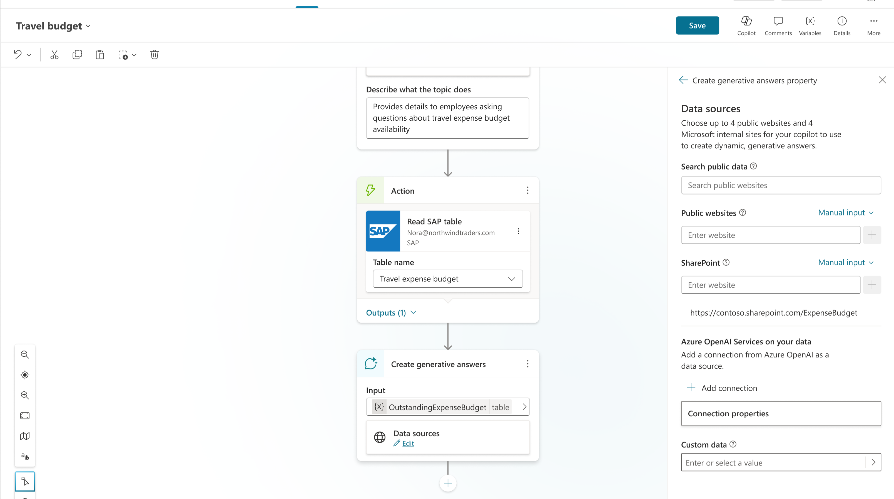
A range of tools for agent creation
No code
Pro code
For end users
For makers
For developers
Agent builder
Copilot Studio
Copilot Studio, Azure AI Foundry & Visual Studio
Data protection, agent sharing & usage limits, and reporting & cost management
Notes:
Not everyone building these agents is a developer — and that’s okay. Copilot Studio supports the full spectrum of makers:
For end users, the Agent Builder provides a simple, guided way to create agents without code.
For makers, Copilot Studio offers a low-code experience with more customization.
For developers, it integrates with Azure AI Foundry and Visual Studio for deep, pro-code extensibility. This means Alex can start with simple automations and grow into more complex, multi-system agents as needs evolve — all in one connected environment.
Copilot Studio offers a range of tools for agent creation—whether you’re a no-code maker or a pro-code developer.
You can build agents visually, use templates, or dive into advanced coding with Azure AI Foundry and Visual Studio.
There are options for end users, agent builders, and developers alike.
Key features include data protection, agent sharing, usage limits, and robust reporting and cost management.
This flexibility ensures that anyone in your organization can contribute to building and deploying intelligent agents.

Slide 12








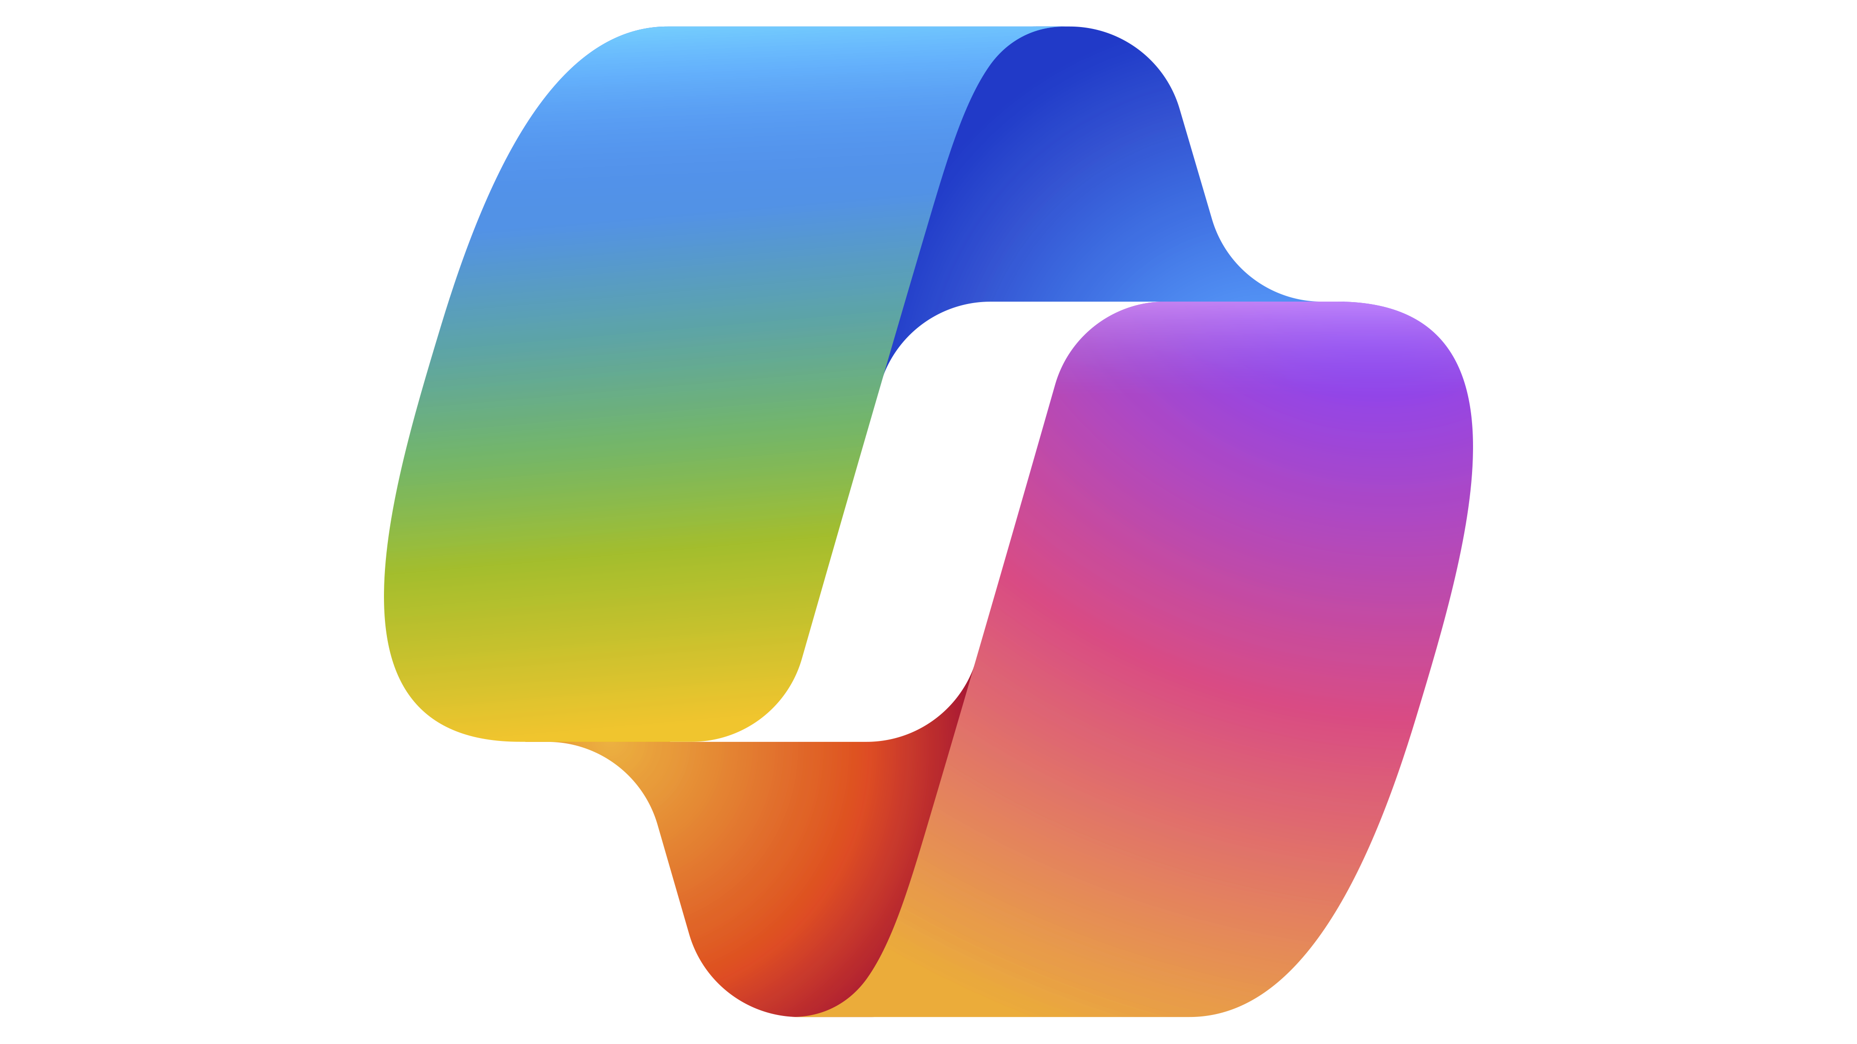





















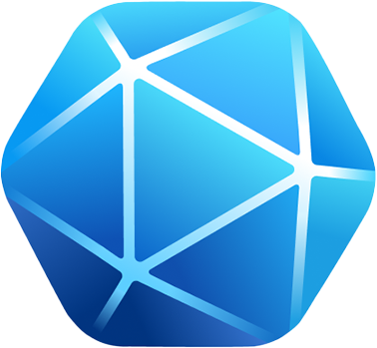


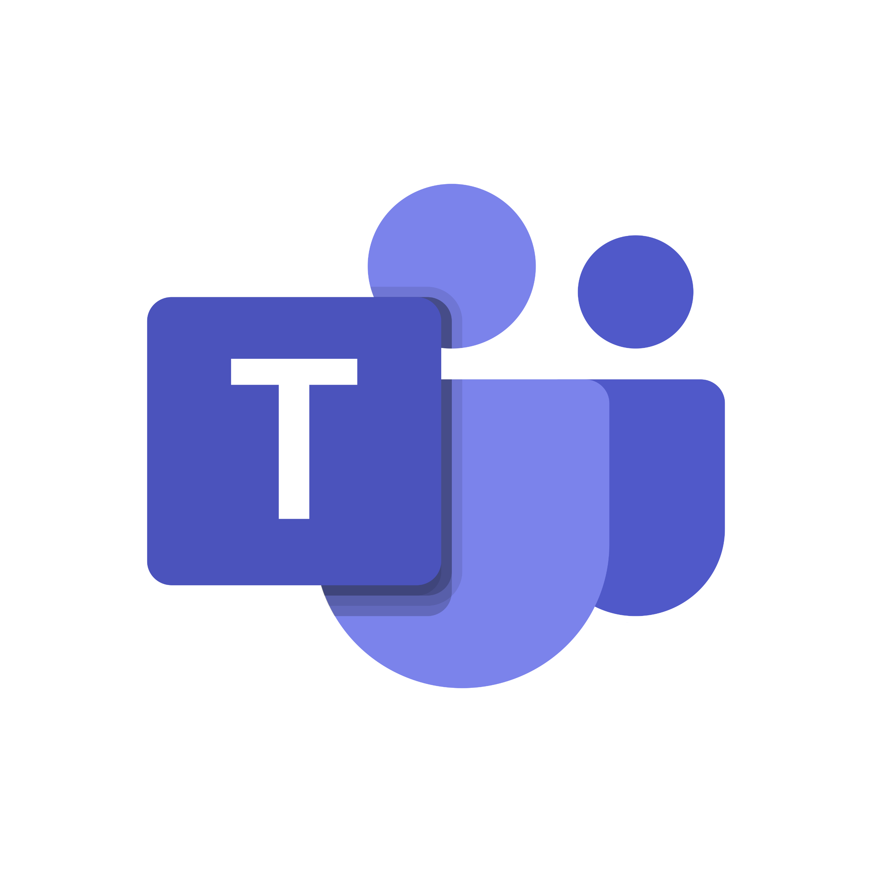

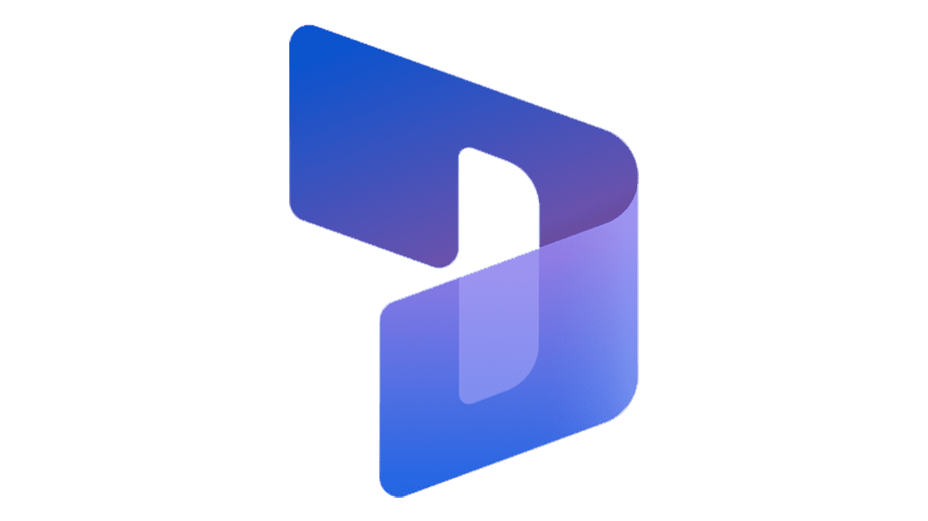

How does it all fit together?
1 - Trigger
2 - Instructions
3 - Plan
4 - Outcome
Agent automatically reacts to triggers
Agent follows your instructions
Agent completes the ask using your data and knowledge
Agent generates a response
Refunds and replacements
Company website
Send an email
Analyze an image
Message in Copilot
Agent
I recently purchased a product from your company, but unfortunately, it arrived broken. I would like to request a replacement. Could you please assist me with this?
Hi there! The Refund agent needs your approval on a replacement request over £200:
When a new email arrives Office 365 Outlook
Orchestration
Tell your agents when to act
Design your agents’ behavior
Connect your agents to knowledge and applications
Deploy agents to your channels
Build the way you want
*
*
When an item is created SharePoint
Your Data
Natural language
Data connectors External systems
*
When a new hire starts HR Management
Pre-built templates
Recurrence Schedule
Visual canvas
Microsoft Graph Productivity data (M365)
* Access this channel by connecting to an ISV
Code
Microsoft Dataverse Business data
Notes:
So, how do all these components work together in practice?
The agent lifecycle starts with a trigger—this could be a user action, a scheduled event, or a change in data.
Next, the agent follows instructions—these define what the agent should do and how it should behave.
The agent then creates a plan—deciding which actions to take, which data to use, and how to achieve the desired outcome.
Finally, the agent delivers an outcome—completing the task, generating a response, or orchestrating further actions.
You can design agents using natural language, pre-built templates, visual canvases, or code—whatever fits your workflow.
Agents can connect to a wide range of data sources and applications, from Microsoft Graph and Dataverse to external systems and business data.
The key is orchestration—bringing together triggers, instructions, planning, and execution for seamless automation.

Slide 13
Instructions are key to success
A well-structured set of instructions ensures that the agent understands its role and tasks and how to interact with users.
Purpose
General directions
Tone
Guidelines
Restrictions
Terminology
Skills
Skill 1
Description
Step-by-step workflow
Sample output
Skill 2
Description
Sample output
Skill 3
Description
Step-by-step workflow
Skill n
…
Notes:
Instructions play a crucial role in shaping how generative autonomous agents behave and respond.
Instructions guide the agent in:
Determining actions or knowledge sources to use in response to a user query or autonomous trigger.
Filling inputs for actions based on the available context.
Generating responses that align with the desired tone, format, and content [1].
You instructions should list the task of the agent and be clear and contextual.
Instructions should also specifically call out the tools and knowledge sources it should use.
References
[1] Guidance for using instructions in generative mode - Microsoft Copilot ...
[2] Optimize prompts with custom instructions - Microsoft Copilot Studio

Slide 14
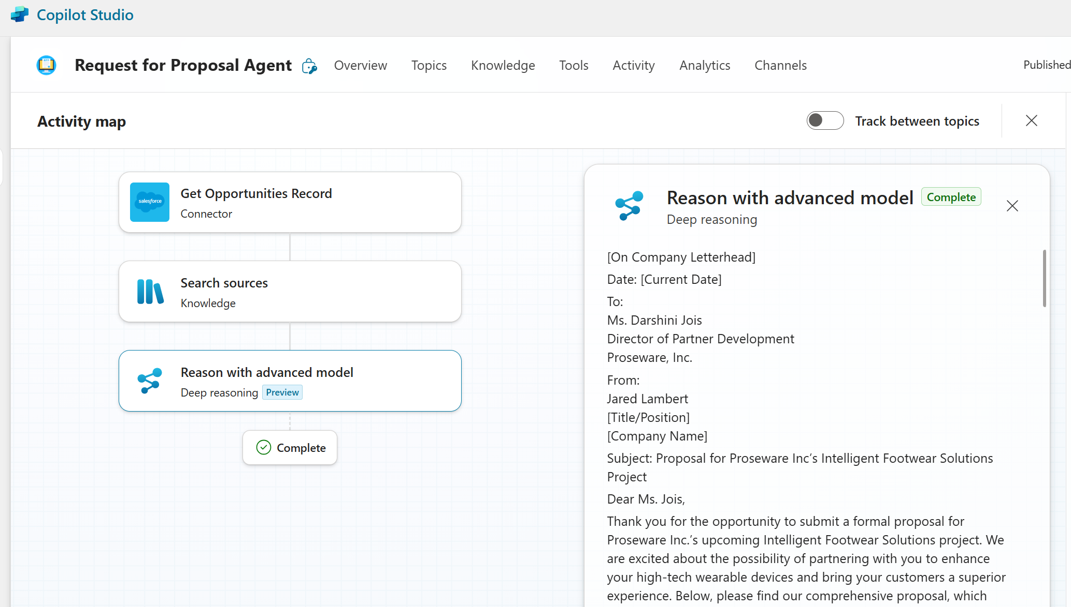
Deep reasoning
Preview
Execute ambiguous and multi-faceted business processes
Step by step approach to tasks requiring deliberation and problem solving
Currently uses OpenAI o1, o3 and o4 coming
Reports, tables and optimization tasks
Recent customer examples:
Request for Proposals (RFPs), contract reviews, market analysis and compliance checks.
Notes:
Deep Reasoning uses the OpenAI o1 model to allow your agents to follow a step-by-step approach for tasks. This is best explained by a demo. Let’s take a look at the same agent with and without deep reasoning enabled.

Slide 15
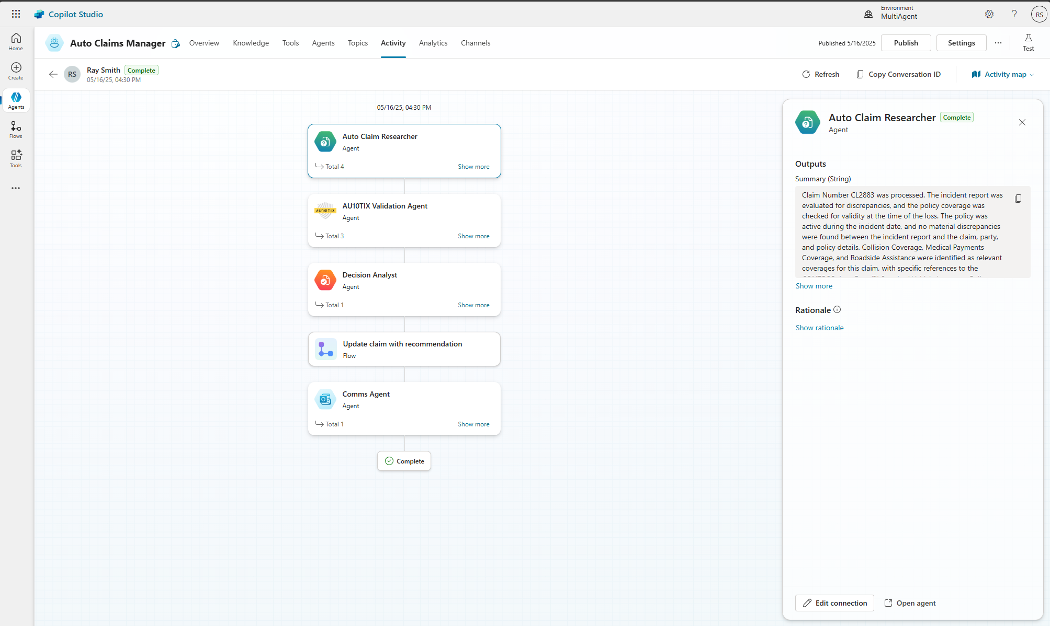
Multi-agent orchestration
Preview
Orchestrate intelligent agents to deliver reliable, scalable outcomes
Build and scale with modular, composable agent architecture
Coordinate across agents with generative orchestration
Enable cross-team collaboration with reusable agent components
Gain visibility with built-in debugging and traceability
Notes:
Building on that, let’s talk about multi-agent orchestration—a key capability for advanced automation.
With multi-agent orchestration, you can coordinate intelligent agents to deliver reliable, scalable outcomes.
This means building and scaling with a modular, composable agent architecture, where each agent specializes in a specific function.
Generative orchestration allows agents to collaborate, share information, and coordinate actions across teams and departments.
You also gain visibility with built-in debugging and traceability, making it easier to monitor, troubleshoot, and optimize your agent ecosystem.
The result is a robust, flexible automation platform that can handle even the most complex business scenarios.

Slide 16
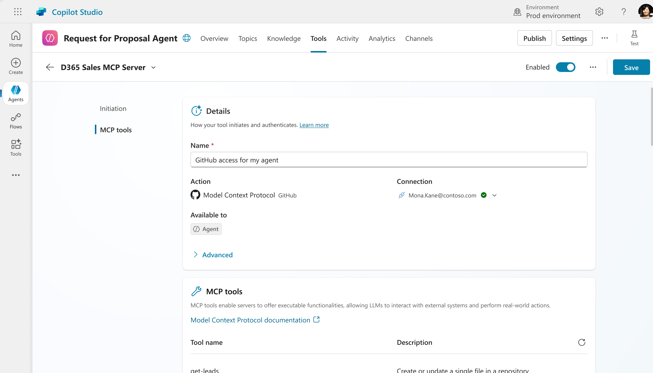
Model Context Protocol
Preview
A universal interface that allows AI models to interact with external tools, data sources, and user environments in a consistent and scalable way
Standardized Context for AI Models
Seamless Integration with Copilot Studio
Improved Developer Efficiency and UX
Governance, Monitoring, Extensibility
Notes:
To address these integration challenges, Microsoft is introducing the Model Context Protocol—a universal interface for AI models.
This protocol allows AI models to interact with external tools, data sources, and user environments in a consistent and scalable way.
With standardized context, seamless integration with Copilot Studio, and improved developer efficiency, you can build more powerful and flexible agent solutions.
The protocol also supports governance, monitoring, and extensibility, making it easier to manage and evolve your AI ecosystem as your needs change.

Slide 17
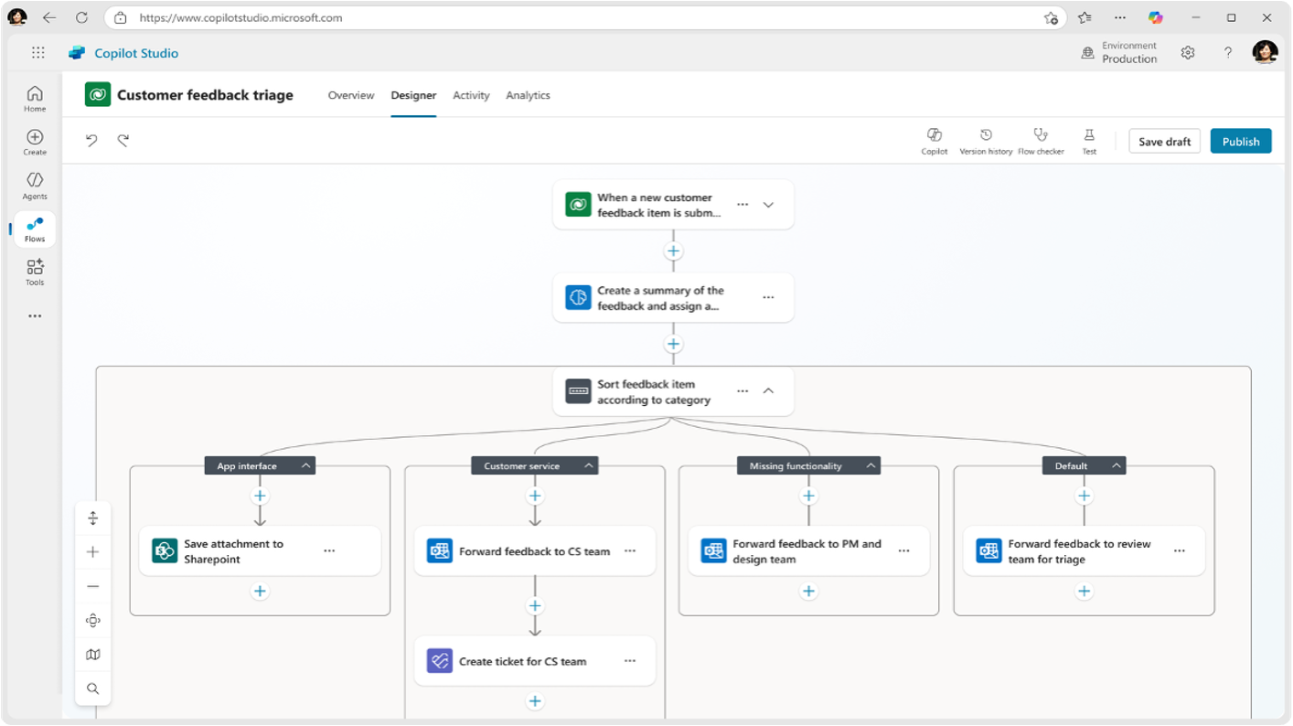
Agent flows
Generally available
Increased control over your agentic outcomes with fixed automation pathways
Agent flows execute repetitive tasks quickly by precisely following a predefined sequence.
Accomplish objectives faster by skipping reasoning where appropriate
Advanced features like multi-stage and conditional approvals to manage complex approval workflows
Notes:
o address the need for determinism, Copilot Studio introduces Agent Flows.
Agent Flows give you increased control over your agentic outcomes by defining fixed automation pathways.
These flows are generally available and are designed to execute repetitive tasks quickly by following a predefined sequence—no reasoning required for every step.
This approach helps you accomplish objectives faster and more reliably, especially for tasks that don’t require dynamic decision-making.
Advanced features like multi-stage and conditional approvals make it easy to manage even complex workflows, such as multi-level approvals in finance or HR.

Slide 18
Models in Copilot Studio
Copilot Studio offers model choice flexibility consistently across knowledge, tools, & prompts
Managed Models
Bring Your Own Model
Best-in-class models curation for specific scenarios
No change management for new model releases
No need for management your own GPU infra
Ensure Responsible AI controls apply by default
Enable self-managed access to custom models from Azure AI Model Catalog
Control the model instructions with access to Copilot Studio tools
Default model ¹
vNext model ²
Scenario specific models ^{3, 4}
Fine-Tuning service
1,900+ models from Azure AI Foundry ⁵
Models fine-tuned using Azure
¹Currently GPT 4o | ²Currently GPT 4.1 | ³Like reasoning, CUA,. Code-gen etc. | ⁴Currently o1 & o3-mini for reasoning | ⁵Launching in response generation as preview
Notes:
Another important piece of the puzzle when building Agents is choosing the AI model to use. Different models are better at different kinds of work — some excel at speed, some at deep reasoning, others at summarization or structured outputs. One of the big benefits of Copilot Studio is that it doesn’t lock you into a single model — you get the flexibility to pick the right one for the job
For most scenarios, Alex can rely on managed models — best-in-class AI models that Microsoft curates, hosts, and keeps updated.
There’s no GPU infrastructure to manage.
No model update headaches.
Responsible AI controls are applied automatically. This means Alex gets reliable, enterprise-ready AI with zero extra overhead — perfect for routine supply chain tasks like summarizing supplier performance or drafting customer updates.
But sometimes Zava has unique needs — maybe a specialized forecasting model that the data science team has already fine-tuned on years of shipping data.
Copilot Studio offers flexible model choices across knowledge, tools, and prompts.
You can select from managed models, best-in-class models curated for specific scenarios, or even bring your own models from the Azure AI Model Catalog.
There’s no need to manage your own GPU infrastructure or worry about model updates—Copilot Studio handles it for you.
Responsible AI controls are applied by default, ensuring compliance and ethical use.
With over 1,900 models available, including fine-tuned and scenario-specific options, you have the flexibility to tailor your agents for any business need.

Slide 19

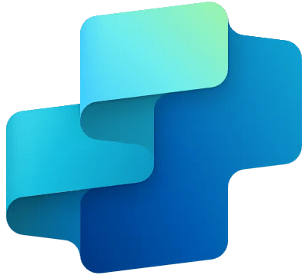

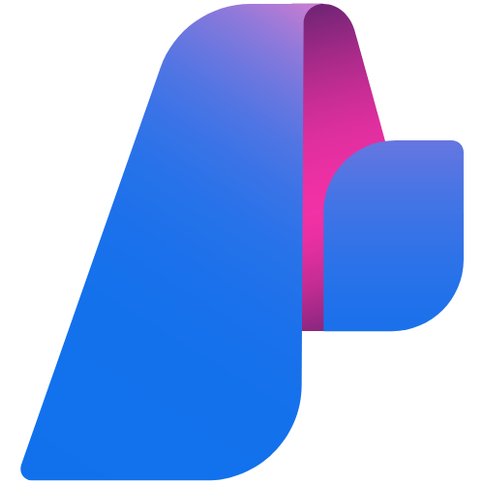
Bring your own model
Transform your business with Azure AI Foundry Models in Copilot Studio—unlocking smarter, faster, and more efficient solutions
Access to Azure AI Foundry models
Improving Efficiency
Improving Quality
Prompt
Copilot Studio
Agents
Azure AI Foundry Models
O1
LLAMA
Phi-4
Claude
Gemini
GPT 4.1
DeepSeek
Mistral 3B
Accelerating timelines
Support for Innovation
Azure AI Foundry
Notes:
With Copilot Studio, Alex can bring that custom model in from Azure AI Foundry and use it right alongside the managed models. That means Zava gets the best of both worlds:
Managed models for reliability and ease.
Custom models when they want a competitive edge or highly tailored reasoning. And Alex doesn’t need to switch platforms — all of this happens inside Copilot Studio.
Finally, let’s talk about bringing your own model into Copilot Studio.
With Azure AI Foundry Models, you can unlock smarter, faster, and more efficient solutions tailored to your business.
You have access to a wide range of models—O1, LLAMA, Phi-4, Claude, Gemini, GPT 4.1, DeepSeek, Mistral 3B, and more.
This supports innovation, improves efficiency and quality, and accelerates your timelines.
By combining your own models with Copilot Studio’s orchestration and prompt capabilities, you can transform your business processes and drive real impact.

Slide 20
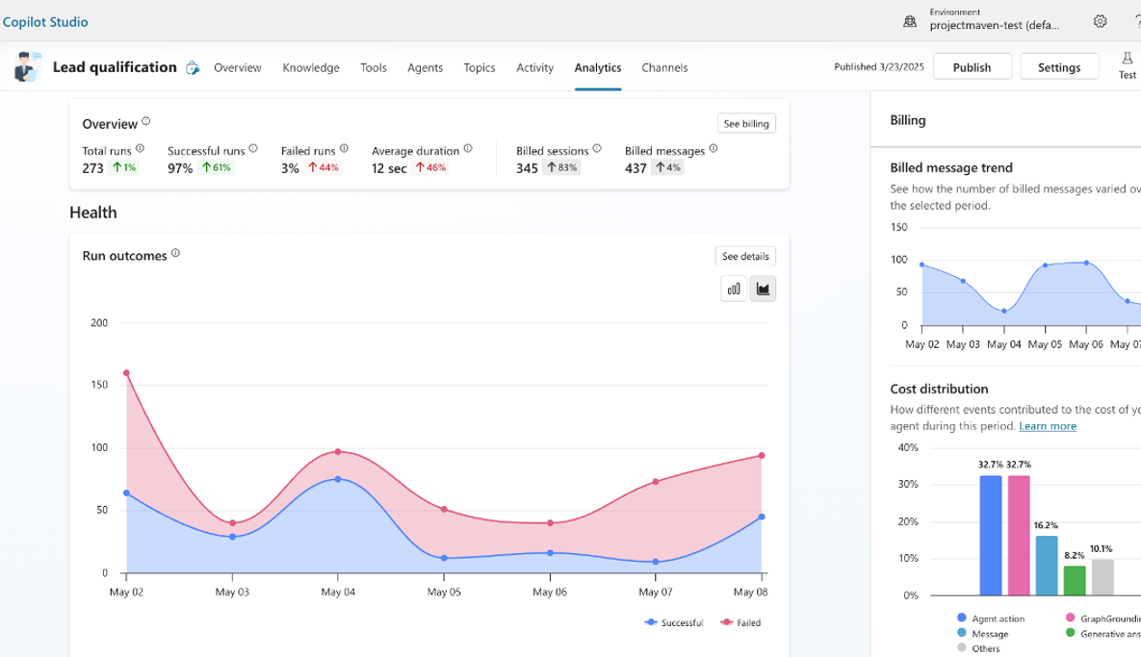
Analytics & Insights
Generally available
Gain visibility into how your autonomous agents perform
Top KPIs
Total runs for the report period
Breakdown by successful & failed runs
Trend analysis over-time to easily identify areas that require close attention
Average run duration
Consumption analysis
Understand costs related to your agent in a detailed billing consumption report.
Message consumption over time.
Breakdown between type of events.
Notes:
Let’s dive into analytics and insights—now generally available in Copilot Studio.
You can gain visibility into how your autonomous agents perform using key performance indicators (KPIs).
Track total runs, breakdowns by successful and failed runs, and trend analysis over time to spot areas needing attention.
Analyze average run duration and consumption metrics, including detailed billing and message consumption reports.
These insights help you understand costs, usage patterns, and opportunities for optimization.

Slide 21
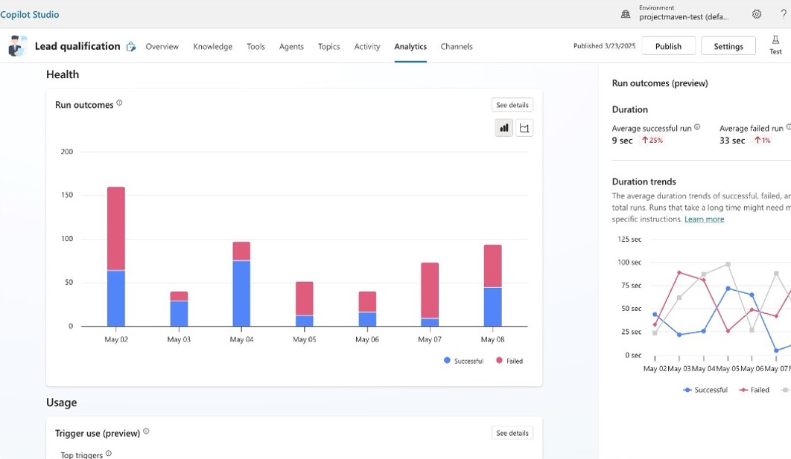
Analytics & Insights
Generally available
Get visibility to how your autonomous agents perform
Agent Health
Review agent run trends over time
Duration analysis, split by successful and failed run
Duration trends over time analysis
Notes:
Analytics also provide a deep look into agent health.
Review agent run trends over time and analyze duration, split by successful and failed runs.
Duration trends help you identify bottlenecks or inefficiencies in your workflows.
With this data, you can proactively address issues and ensure your agents are running smoothly and efficiently.

Slide 22
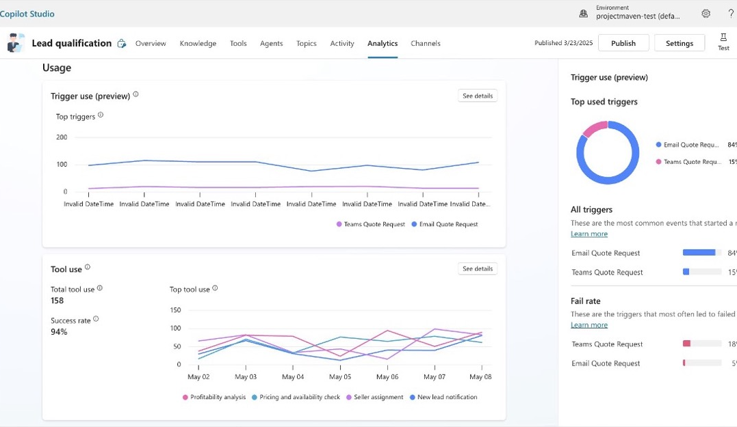
Analytics & Insights
Generally available
Get visibility to how your autonomous agents perform
Trigger usage
View agent runs by different triggers
Success rate for each trigger
Tool usage
See how different tools are performing
Tool usage over time
Notes:
Copilot Studio’s analytics let you drill down into trigger and tool usage.
See how often agents are run by different triggers and the success rate for each.
Analyze which tools are being used, how often, and how their usage changes over time.
This level of detail helps you fine-tune your agent ecosystem, allocate resources, and maximize the value of your automation investments.

Slide 23
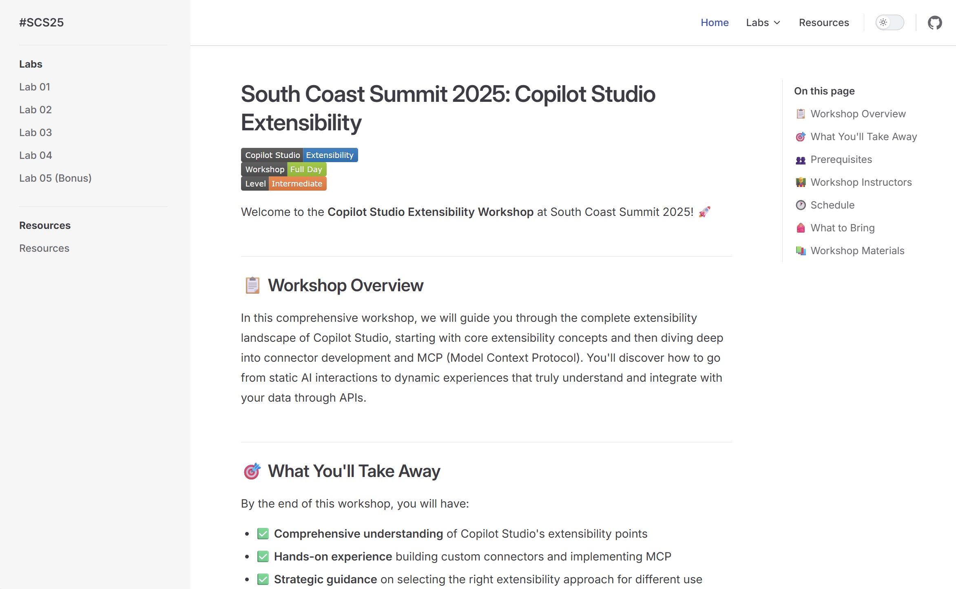
Lab Instructions

Slide 24
Lab 01
Setup
https://aka.ms/scs25-copilot-studio

Slide 25




Thank you
Please provide feedback
Notes:
MANDATORY SLIDE – “Please use the QR code to provide session feedback.”

